Slide 1
CHAPTER 5:
REGRESSION
The Basic Practice of Statistics
6th Edition
David S. Moore
Lecture Powerpoint
Notes:
Basic Practice of Statistics - 3rd Edition
Chapter 5

Slide 2
Chapter 5 Concepts
Regression Lines
Least-Squares Regression Line
Facts about Regression
Residuals
Influential Observations
Cautions about Correlation and Regression
Correlation Does Not Imply Causation

Slide 3
Chapter 5 Objectives
Quantify the linear relationship between an explanatory variable (x) and a response variable (y).
Use a regression line to predict values of (y) for values of (x).
Calculate and interpret residuals.
Describe cautions about correlation and regression.

Slide 4
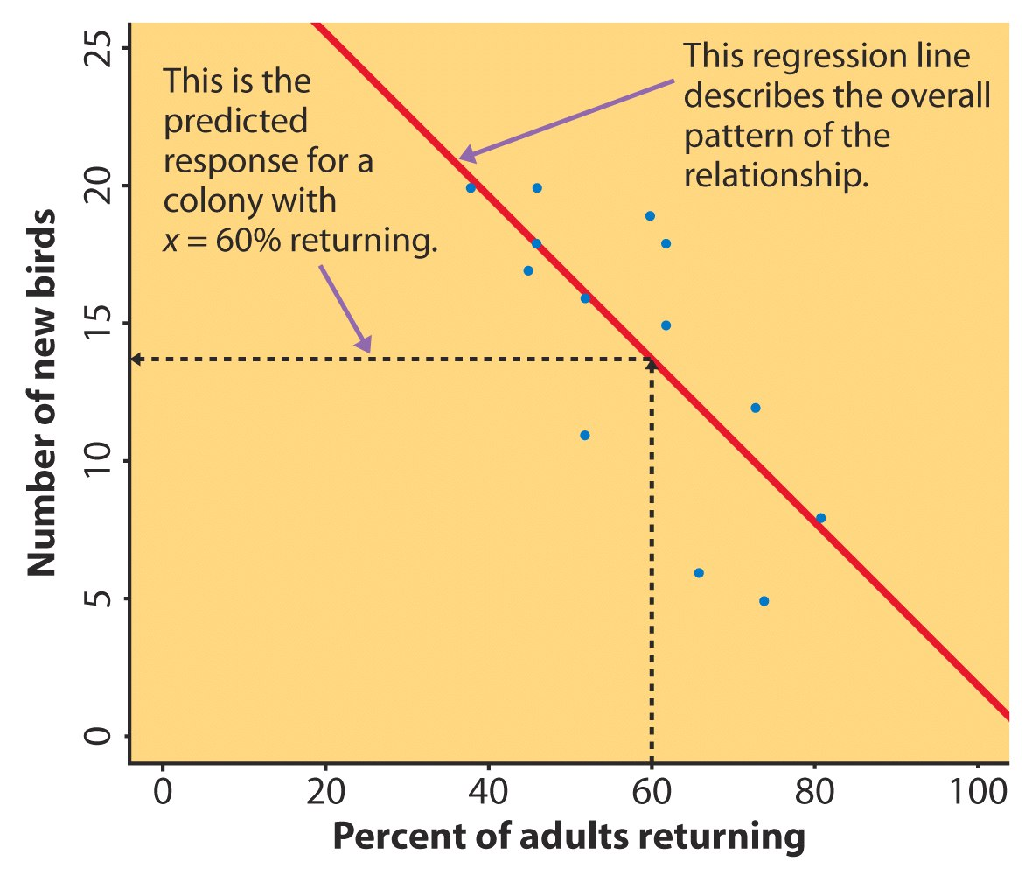
Regression Line
A regression line is a straight line that describes how a response variable y changes as an explanatory variable x changes.
We can use a regression line to predict the value of y for a given value of x.
Example: Predict the number of new adult birds that join the colony based on the percent of adult birds that return to the colony from the previous year.
If 60% of adults return, how many new birds are predicted?

Slide 5
Regression Line
^
Regression equation: y = a + bx
  x is the value of the explanatory variable.
  “y-hat” is the predicted value of the response variable for a given value of x.
  b is the slope, the amount by which y changes for each one-unit increase in x.
  a is the intercept, the value of y when x = 0.

Slide 6
Least-Squares Regression Line
Since we are trying to predict y, we want the regression line to be as close as possible to the data points in the vertical (y) direction.
Least-Squares Regression Line (LSRL):
  The line that minimizes the sum of the squares of the vertical distances of the data points from the line.

Slide 7
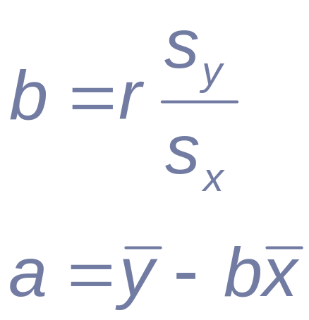
Equation of the LSRL
^
Regression equation: y = a + bx
where s_{x} and s_{y} are the standard deviations of the two variables, and r is their correlation.

Slide 8
Prediction via Regression Line
For the returning birds example, the LSRL is
y-hat = 31.9343 − 0.3040x
  y-hat is the predicted number of new birds for colonies with x percent of adults returning
Suppose we know that an individual colony has 60% returning. What would we predict the number of new birds to be for just that colony?
For colonies with 60% returning, we predict the average number of new birds to be:
31.9343 − (0.3040)(60) = 13.69 birds

Slide 9
Facts about Least-Squares Regression
The distinction between explanatory and response variables is essential.
The slope b and correlation r always have the same sign.
The LSRL always passes through (x-bar, y-bar).
The square of the correlation, r², is the fraction of the variation in the values of y that is explained by the least-squares regression of y on x.
  r² is called the coefficient of determination.

Slide 10
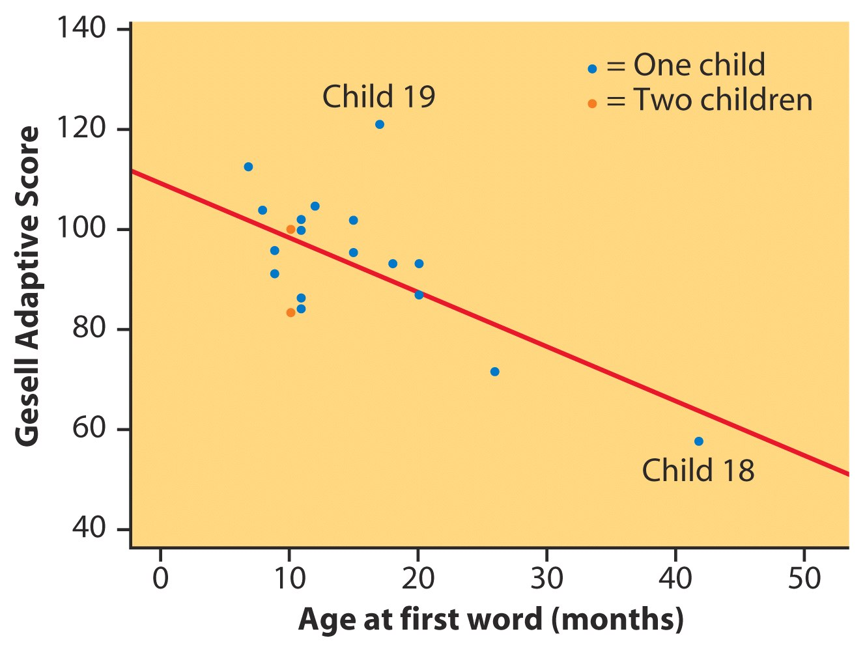
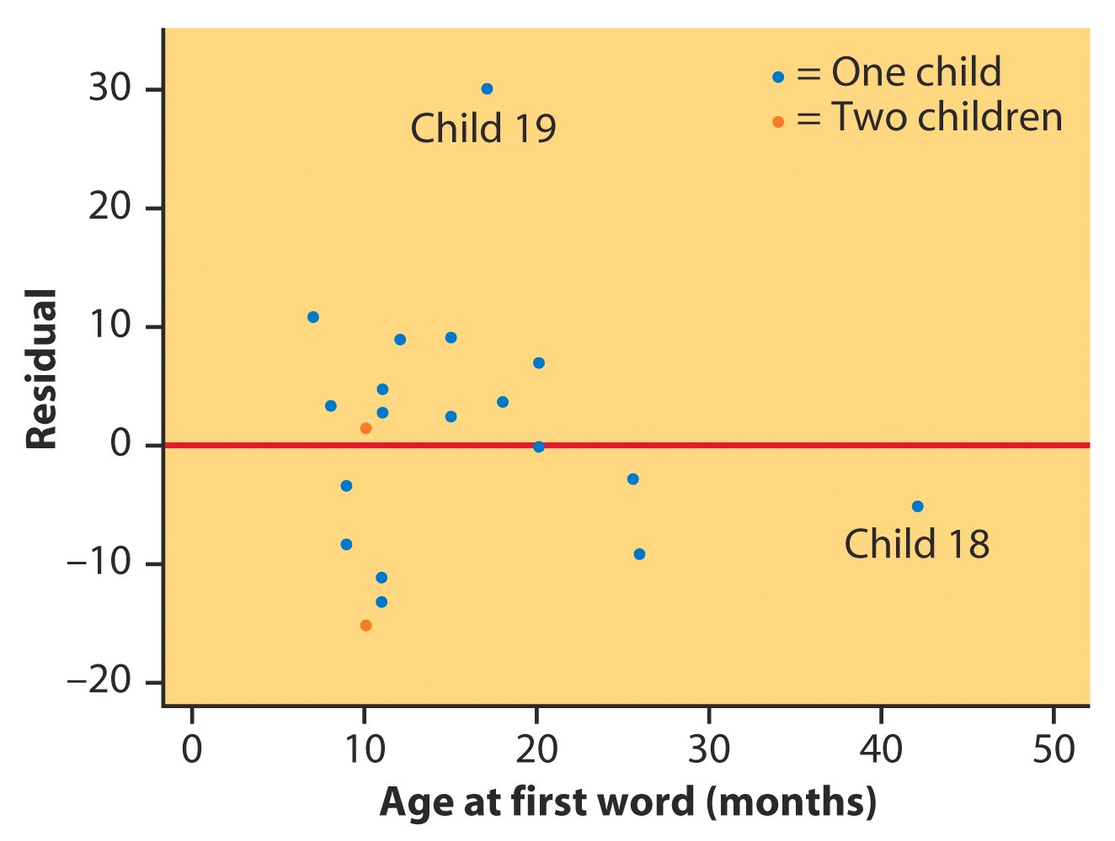
Residuals
Gesell Adaptive Score and Age at First Word
A residual is the difference between an observed value of the response variable and the value predicted by the regression line:
residual = y − y
^
A residual plot is a scatterplot of the regression residuals against the explanatory variable
  used to assess the fit of a regression line
  look for a “random” scatter around zero

Slide 11
Outliers and Influential Points
An outlier is an observation that lies far away from the other observations.
  Outliers in the y direction have large residuals.
  Outliers in the x direction are often influential for the least-squares regression line, meaning that the removal of such points would markedly change the equation of the line.

Slide 12
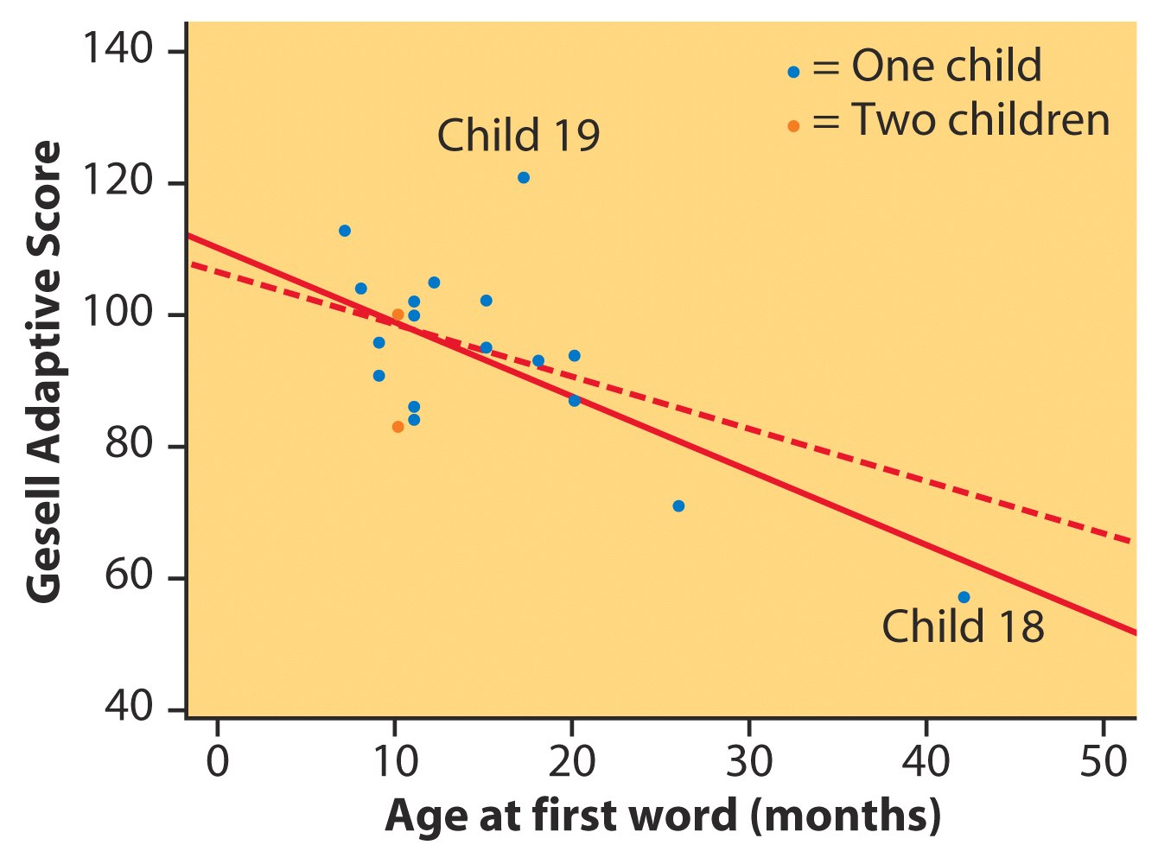
Outliers and Influential Points
Gesell Adaptive Score and Age at First Word
After removing child 18
r² = 11%
From all of the data
r² = 41%
Chapter 5

Slide 13
Cautions about Correlation and Regression
Both describe linear relationships.
Both are affected by outliers.
Always plot the data before interpreting.
Beware of extrapolation.
  predicting outside of the range of x
Beware of lurking variables.
  These have an important effect on the relationship among the variables in a study, but are not included in the study.
Correlation does not imply causation!

Slide 14
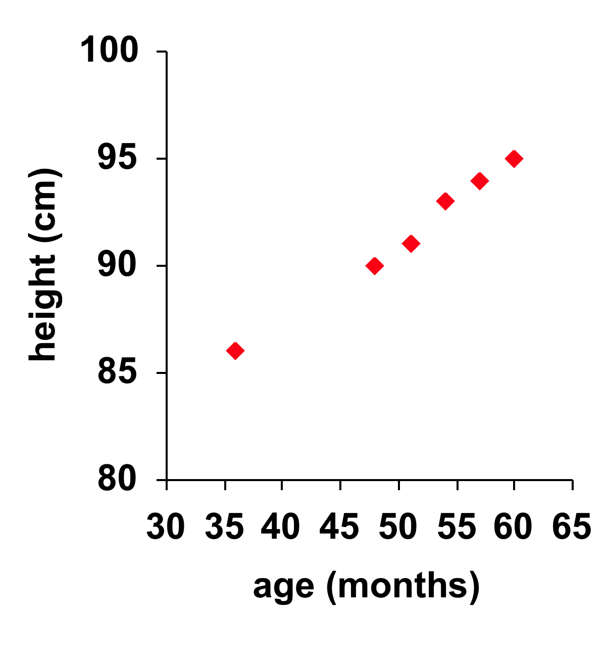
Caution: Beware of Extrapolation
Sarah’s height was plotted against her age.
Can you predict her height at age 42 months?
Can you predict her height at age 30 years (360 months)?

Slide 15
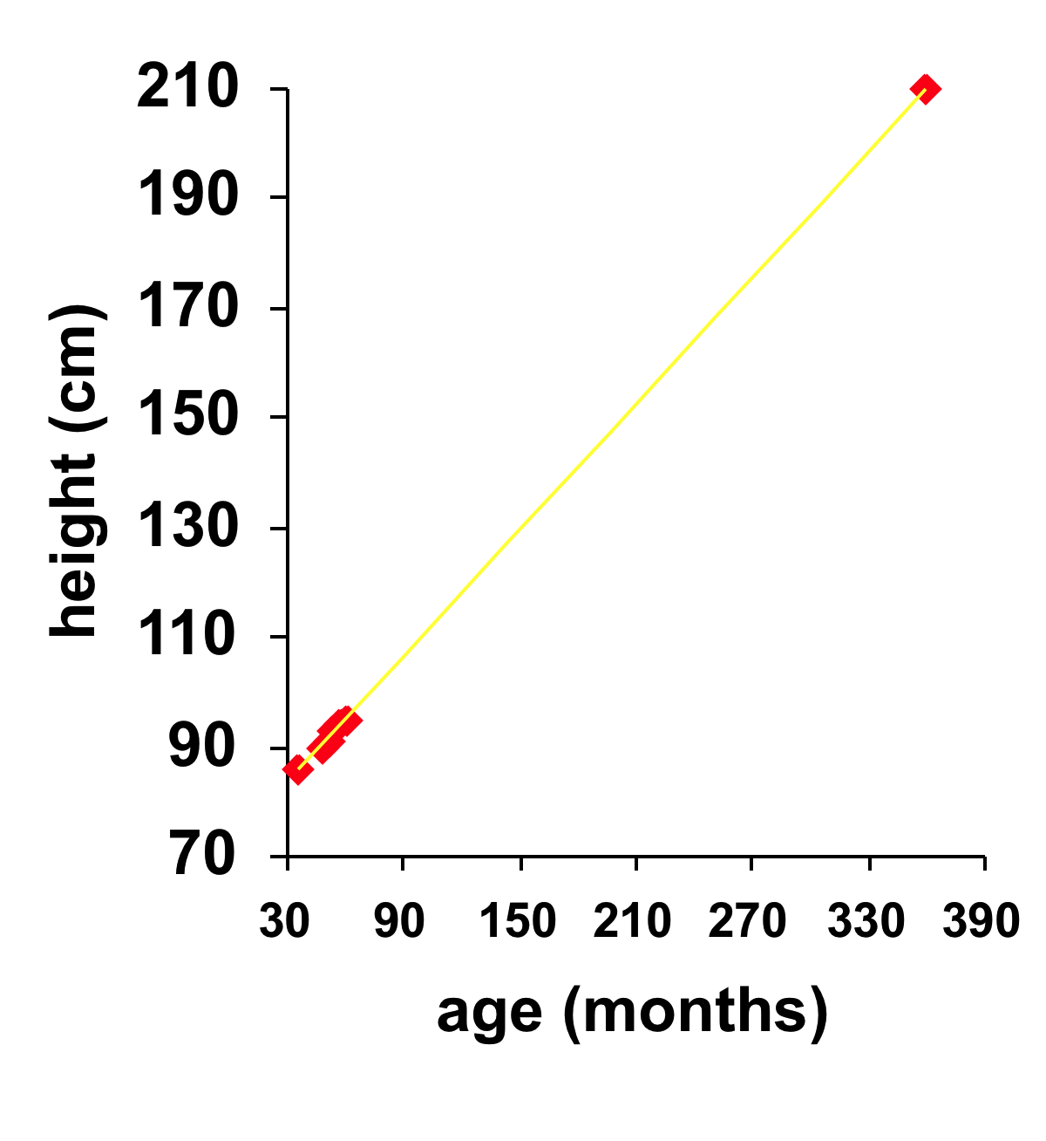
Caution: Beware of Extrapolation
Regression line:
y-hat = 71.95 + .383 x
Height at age 42 months? y-hat = 88
Height at age 30 years? y-hat = 209.8
  She is predicted to be 6’10.5” at age 30!

Slide 16
Example: Meditation and Aging
(Noetic Sciences Review, Summer 1993, p. 28)
Caution: Beware of Lurking Variables
Explanatory variable: observed meditation
practice (yes/no)
Response variable: level of age-related enzyme
General concern for one’s well being may also be affecting the response (and the decision to try meditation).
Notes:
Basic Practice of Statistics - 3rd Edition
Chapter 5

Slide 17
Correlation Does Not Imply Causation
Even very strong correlations may not correspond to a real causal relationship (changes in x actually causing changes in y).
  Correlation may be explained by a lurking variable
Social Relationships and Health
House, J., Landis, K., and Umberson, D. “Social Relationships and Health,” Science, Vol. 241 (1988), pp 540-545.
Does lack of social relationships cause people to become ill? (there was a strong correlation)
  Or, are unhealthy people less likely to establish and maintain social relationships? (reversed relationship)
  Or, is there some other factor that predisposes people both to have lower social activity and become ill?
Notes:
Basic Practice of Statistics - 3rd Edition
Chapter 5

Slide 18
Evidence of Causation
A properly conducted experiment may establish causation.
Other considerations when we cannot do an experiment:
  The association is strong.
  The association is consistent.
    The connection happens in repeated trials.
    The connection happens under varying conditions.
  Higher doses are associated with stronger responses.
  Alleged cause precedes the effect in time.
  Alleged cause is plausible (reasonable explanation).
Notes:
Basic Practice of Statistics - 3rd Edition
Chapter 5

Slide 19
Regression Case Study
Per Capita Gross Domestic Product and Average Life Expectancy
for Countries in Western Europe
Country | Per Capita GDP (x) | Life Expectancy (y)
Austria | 21.4 | 77.48
Belgium | 23.2 | 77.53
Finland | 20.0 | 77.32
France | 22.7 | 78.63
Germany | 20.8 | 77.17
Ireland | 18.6 | 76.39
Italy | 21.5 | 78.51
Netherlands | 22.0 | 78.15
Switzerland | 23.8 | 78.99
United Kingdom | 21.2 | 77.37

Slide 20
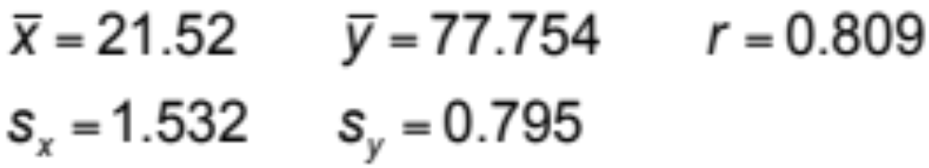
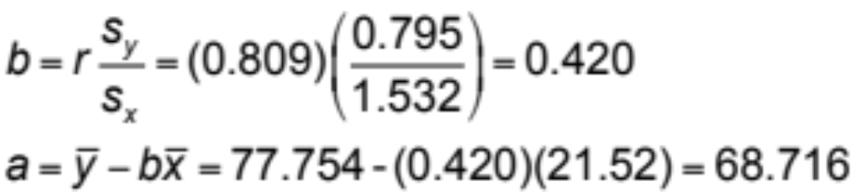
Regression Case Study
Least-Squares Regression Line Equation:
^
y = 68.716 + 0.420x

Slide 21
Chapter 5 Objectives Review
Quantify the linear relationship between an explanatory variable (x) and a response variable (y).
Use a regression line to predict values of (y) for values of (x).
Calculate and interpret residuals.
Describe cautions about correlation and regression.

